Slide 1
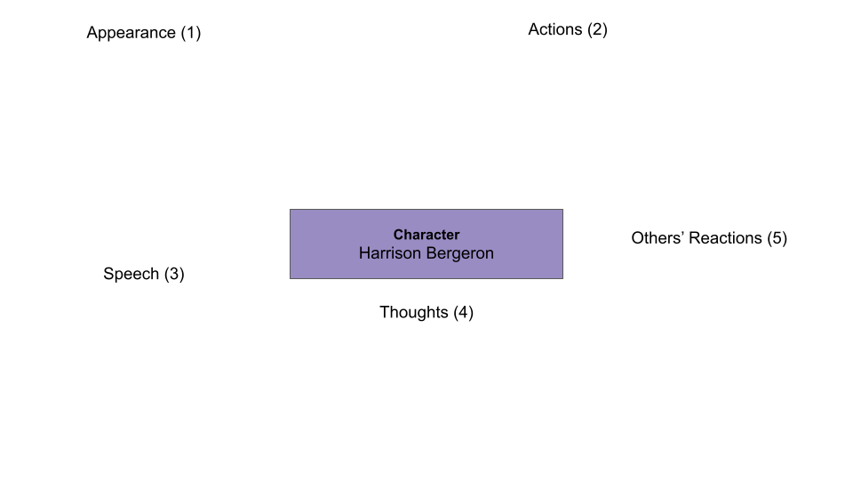
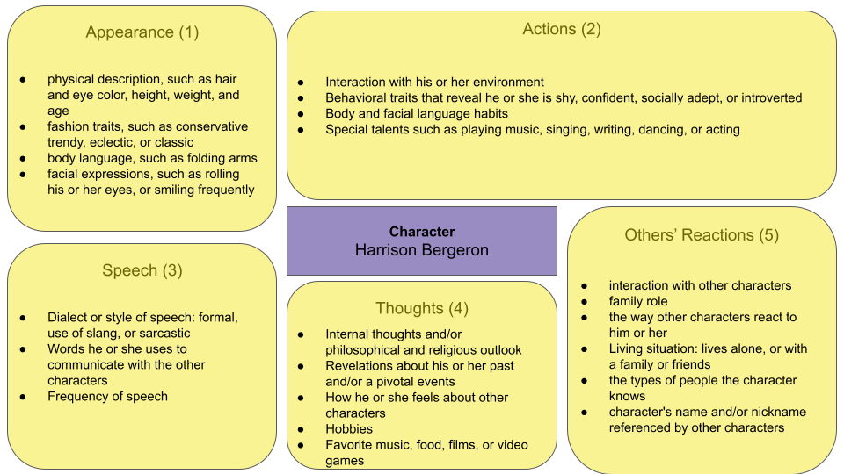
Insert text
Insert text
Insert text
Insert text
Insert text

